Slide 1




Credit Card Default (End to End Case Study) Anjana Agrawal 4th Dec & 5th Dec , 2021

Slide 2
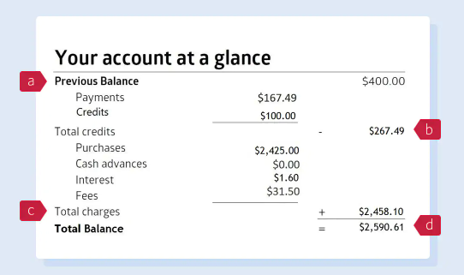
Preliminary Glimpse of a Credit Card Statement
Previous balance is the total balance that appeared on your last credit card statement.
b) Any payments you made or credits posted to your account after your last statement period are subtracted from the money you owe.
c) Total charges is the total amount of your purchases, cash advances, interest and fees. Cash advances include balance transfers and convenience cheques.
d) Total balance is your total outstanding amount at the end of the statement period.
To calculate your total balance, take your previous balance, subtract your credits and payments, and add your total charges.

Slide 3
Credit Card Terminology
Minimum Amount Due - The minimum amount due on a credit card is the minimum amount you are required to pay, on or before the payment due date, to ensure that you do not have to pay late fees.
Instalment Plan - An Instalment Plan is a way to spread the cost of a large purchase for a one-off fee.
Revolving Credit - Revolving credit in the case of credit cards is a means of obtaining a deferred payment facility on a continues basis for the purchases made on the credit card. The person needs to pay only the minimum amount, which is about 5% of the total amount of the bill. However revolving credit card facility comes with a price.

Slide 4
Dataset Facts
You become delinquent after missing a payment for 30 days. Default usually happens after six months in a row of not making at least the minimum payment due.
However bank while analysing considers you as a defaulter even if you have missed out one payment cycle

Slide 5
Case Study
AA Bank Ltd , over the last 4 years, have observed an exponential increase in the credit card payment defaulters.
Preliminary Analysis was conducted by the bank to understand if any pattern could be observed based on demographic details so that appropriate checks /rules could be imposed while issuing the credit card. However, this effort has really not benefited the bank.
Hence, they have requested your support.
This time bank has also collected some additional information related to their bill amount, payment amount along with how each customer really uses the bank option to carry forward the payment amount to next month or payment delay was observed for how many months or use revolving amount etc.
Your task is two-fold
Identify if bank needs to impose some rules based on the insights generated from historical data so that they can keep an eye on the "potential defaulters“.
(ii) Build a model so that the bank can estimate the probability of default.

Slide 6
Episode 1
Exploratory Data Analysis of each independent feature with all other independent feature and Target Feature
Perform Statistical Test(s) to understand the feature significance

Slide 7
Episode 2
Feature Selection and Feature Engineering
Model Building and Evaluation
Anomalies

Slide 8

What is Feature Engineering
Feature engineering is the process of using domain knowledge to extract features from raw data (Source- Wikipedia)
The feature engineering process is:
Deciding what features to create;
Creating features;
Checking how the features work with your model;
Discarding Features to test if created feature has reduced the model performance , if needed;

Slide 9
Difference between Feature Engineering & Feature Selection
Feature engineering
Enables to build more complex models than in comparison to what could be made with only raw data.
Also allows to build interpretable models from any amount of data.
Feature selection
Helps to limit these features to a manageable number.
Will reduce the risk of overwhelming the algorithms
Trims down computation time

Slide 10
Even Transformation (like Log), Scaling also changes the original form of the variable/feature…
Can this also be categorised as Feature Engineering ??
Not Really ???

Slide 11
Feature Engineering - Suggestions
Continuous Variables
Binning
Mathematical Calculation (like Defining Ratios, Performing Mathematical operations on two or more than two continuous features, aggregation)
Object Variables
Combining two or more than two categorical/object type variables
Encoding
Grouping based on one or multiple categorical variable
Performing mathematical operations on the group like count, max, min
Date Variables
Extracting Year, Quarter, Month, Day, Day of the week, Weekend, Season

Slide 12
Feature Engineering – Suggestions (contd..)
Text Variables
Extracting Text/Numbers and then accordingly creating features
Any combination of the above mentioned suggestions ...
And Story does not end here… because
Feature Engineering is an ART … Requires Domain Knowledge

Slide 13
Feature Engineering – Caution
Not necessary more is merrier in case of Feature Engineering
Be cautious about Curse of Dimensionality

Slide 14













HAPPY LEARNING

